Slide 1
Video Games Sales Analysis

Slide 2




Team Members
Shahed Faisal MBA/MSIS
Joshua Hockerman MBA/MSIS
John Ogun MSIS
Lee Zhang MBA/MSIS

Slide 3
AGENDA
1
Introduction
4
Implications
2
Data
5
Conclusion
3
Analysis & Findings

Slide 4
Introduction
Focus & purpose of the project

Slide 5
"The gaming industry is likely to maintain its recent rapid growth and increase its worth to $321 billion by 2026."
--World Economic Forum

Slide 6
Business Questions:
Business Questions:
Which genres of video games have the most sales and least sales?
Do specific publishers sell more games, and is that because they have more games in the market or something else?
What is the distribution for both Metacritic scores and user ratings historically for video games?
What is the relationship between Metacritic scores, user ratings and global sales?
What factors matter the most in predicting a game's sales number?

Slide 7
Data Cleaning and Exploration
How did we clean up the dataset and what did we find?

Slide 8


Data
Sourced from Kaggle
Data Attributes & Processing
One dataset contains regional and global sales data
Another dataset contains meta score and user ratings
Merged both datasets matching game titles
Games released from 1996-2022
Sales data in millions of USD
13 variables originally
4,790 rows of data
Removed unnecessary variables like ‘Name’
Replaced ‘tbd’ from User Rating field

Slide 9

Data
Feature Engineering
- Added log Sales columns
- Create Age of each game
- Created variables to aid in statistical analysis
- Made factors for the decision tree
End results
- 31 columns in total
- Used 25 for various exploratory visualization and analysis
Notes:
Genre
Publisher
$ Release_Date
$ Meta_Score
$ User_Rating
$ NA_Sales
$ EU_Sales
$ JP_Sales
$ Other_Sales
$ Global_Sales
$ date
$ Release_Year
$ log_Global_Sales
Genre_factor
Publisher_factor
$ Age_Years
$ Average_Sales
$ Genre_Positive
$ Genre_Negative
$ Average_Sales_binary
$ log_Average_Sales

Slide 10
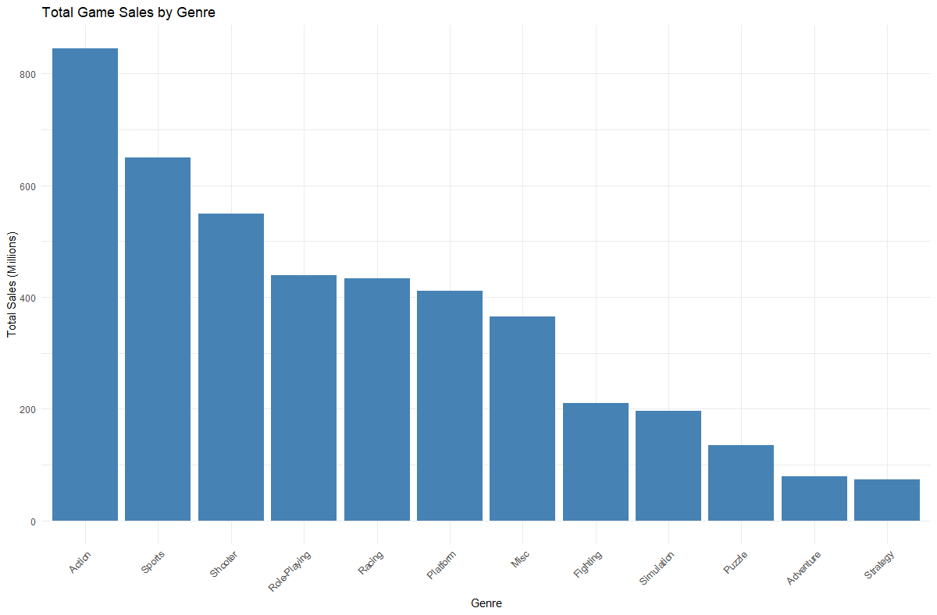
"Action" is at the top of total sales
Notes:
Action, sports and shooting are the top 3 game sales with action having the highest sales.
Puzzle, adventure and strategy has the lowest sales.

Slide 11
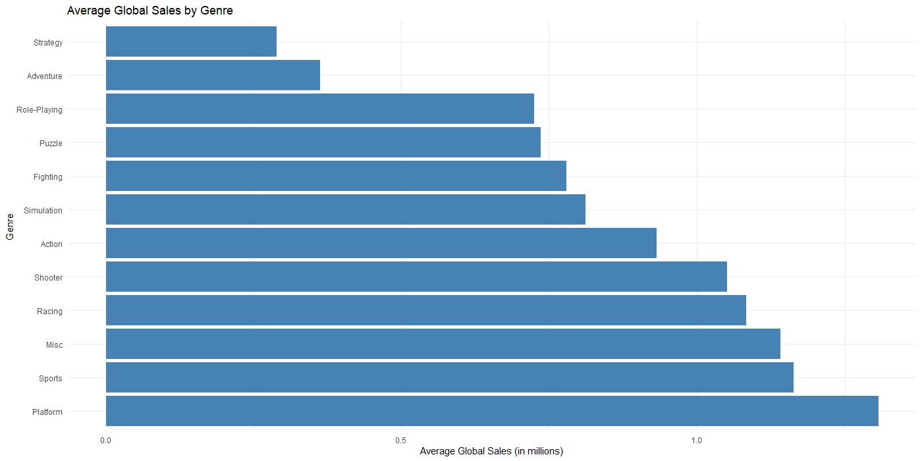
But "Platform" leaps ahead on average
Notes:
Action, sports and shooting are the top 3 game sales with action having the highest sales.
Puzzle, adventure and strategy has the lowest sales.

Slide 12
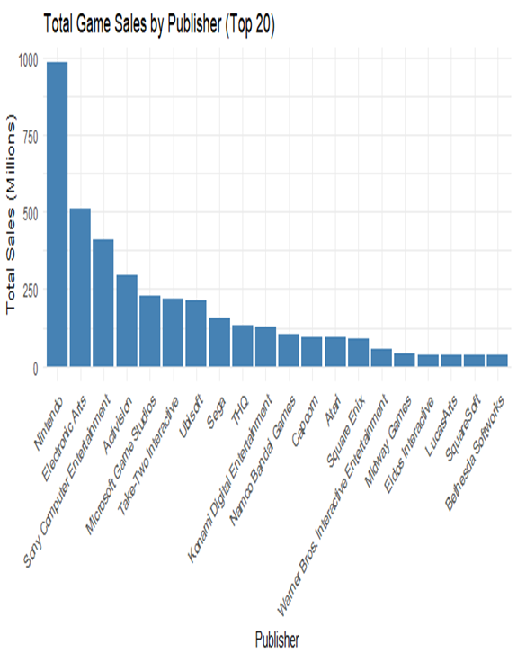
Nintendo totals the most sales

Slide 13
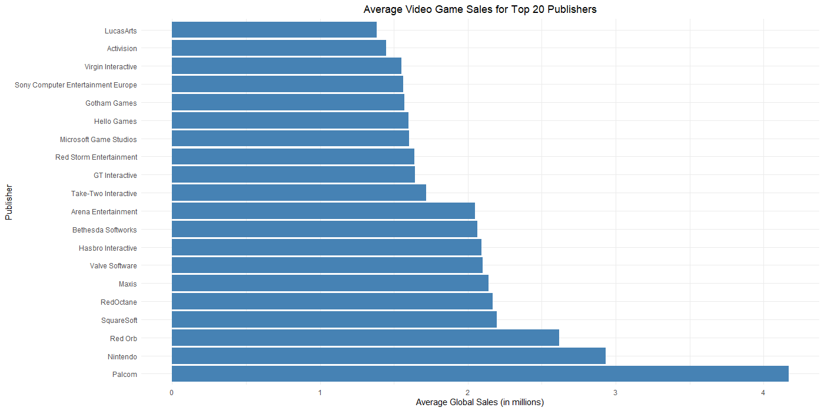
But a competitor averages the most
Notes:
The order changes, but the names mostly stay the same, notable exception at the top is a subsidiary of a large developer, Konami

Slide 14
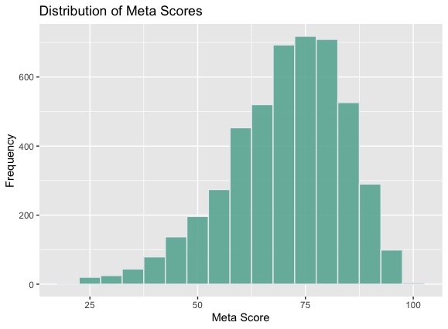
Left-Skewed Meta Score Distribution
Typical Score: 65 to 85
Notes:
Meta Score is skewed to the left
The typical score is between 65 to 85

Slide 15
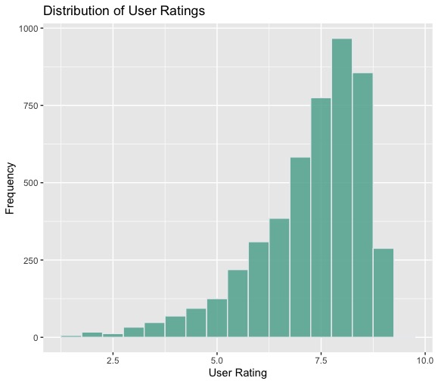
Left-Skewed User Rating Distribution
Typical Rating: 7 to 9
Notes:
User rating is skewed to the left
50% of the user ratings are between 7 and 9

Slide 16
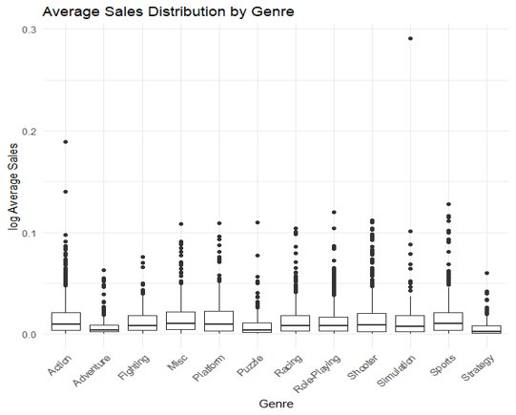
Distinct at the top and bottom but not in the middle
Notes:
Sales are relatively evenly distributed across genres; however, a few genres stand out as higher or lower

Slide 17

Analysis and Findings
What does the data show?

Slide 18
Statistical Analysis of Variables
Correlation Test
- Metacritic Score
- User Score
Chi-Squared Test
- Genres
- Publisher
On regional and global, total and average sales data
These results guided decision tree creation

Slide 19
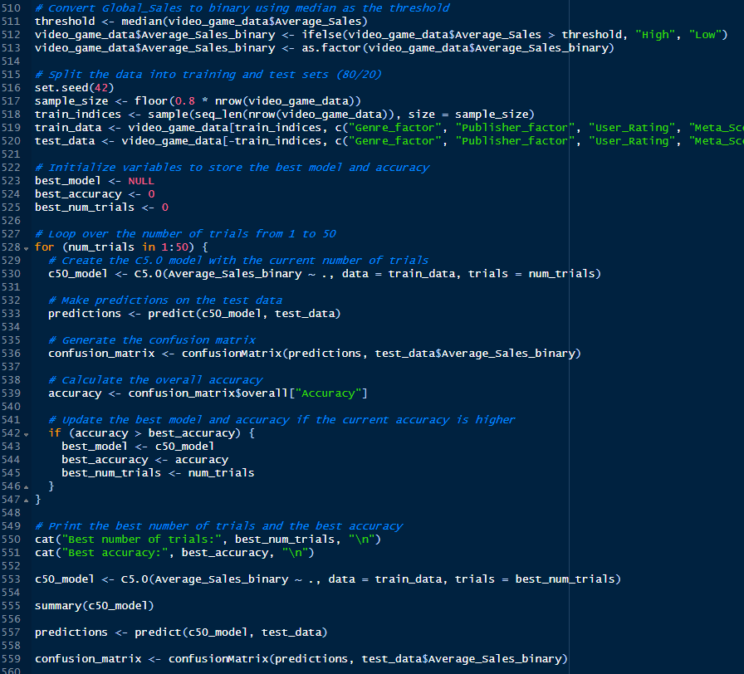
Stepping Through the Decision Tree
Convert to target to binary
Split the data
Loop to find optimal number of trials
Run the optimal regression
Repeat with cost matrix factored in
Create correlation matrix and calculate error
Notes:
Convert Global_Sales to binary using median as the threshold
Split the data into training and test sets (80/20)
Loop over the number of trials to find the optimal number
Run this regression:
c50_model <- C5.0(Average_Sales_binary ~ ., data = train_data, trials = best_num_trials)
Do this again with the cost matrix
Create the correlation matrices and calculate Error

Slide 20
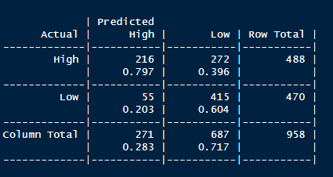
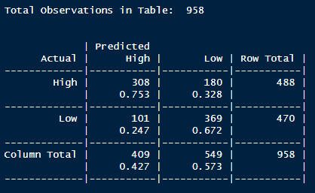
Decision Tree Results
Without cost matrix
- 70.67% accurate
With cost matrix
- 65.87% accurate

Slide 21

Implications
What does this mean?

Slide 22
Implications
From our data analysis, we can conclude that the following variables matter in helping business managers make informed decision.
Game genre
Publishers
Metacritic Score
User Score
Our decision tree has two options to minimize overall error at 70.67% accuracy or to minimize the worst errors by half and an overall accuracy of 65.86% accuracy.
These analysis should provide business managers in the video game industry with insights on where to allocate resources

Slide 23
THANKS!
Any questions?

